Slide 1
CT-LIKE CONTROLLER WITH DISTURBANCE ESTIMATOR
Andreja Rojko

Slide 2
OUTLINE
Introduction
Decoupled CT-like controller
Design of disturbance estimator
Exercise

Slide 3
Introduction
Computed torque like controller with disturbance estimator useful when (most of) the dynamic model is unknown.
This chapter: Decoupled, very robust controller which works well for motion control of most of the robot mechanisms with gears (even with lower reduction ratio).
PI disturbance estimator.

Slide 4
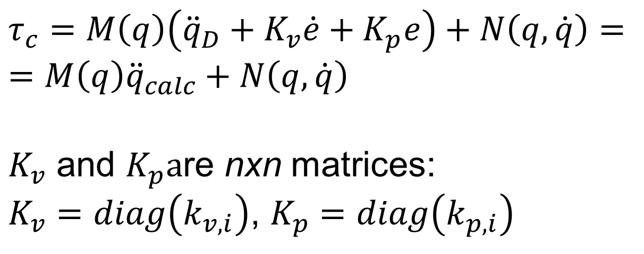
Decoupled CT-like controller
CT controller with proportional + derivative (PD) feedback :
$$τ_{c}=M\left(q\right)\left({\ddot{q}}_{D}+K_{v}\dot{e}+K_{p}e\right)+N\left(q,\dot{q}\right)==M\left(q\right){\ddot{q}}_{calc}+N\left(q,\dot{q}\right)$$
$K_{v}$ and $K_{p}a$re nxn matrices:
$K_{v}=diag\left(k_{v,i}\right)$, $K_{p}=diag\left(k_{p,i}\right)$
Notes:
We had eddot=u+w

Slide 5
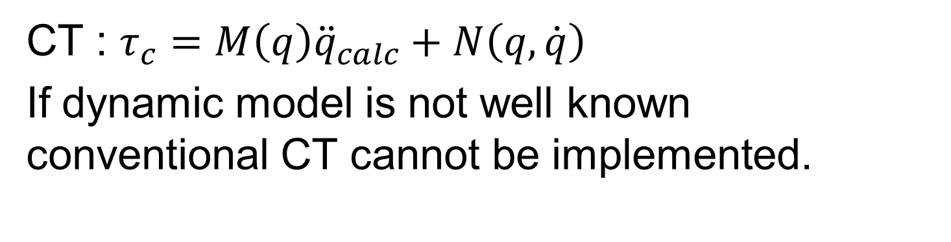
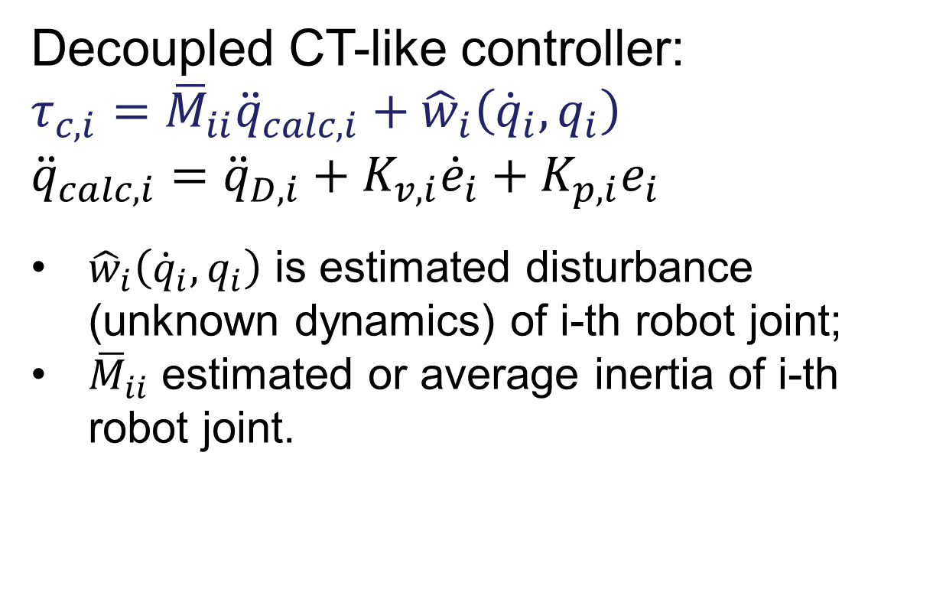
Decoupled CT-like controller
CT : $τ_{c}=M\left(q\right){\ddot{q}}_{calc}+N\left(q,\dot{q}\right)$
If dynamic model is not well known conventional CT cannot be implemented.
Decoupled CT-like controller:
$$τ_{c,i}={\overline{M}}_{ii}{\ddot{q}}_{calc,i}+{\hat{w}}_{i}\left({{\dot{q}}_{i},q}_{i}\right)$$
$${\ddot{q}}_{calc,i}={\ddot{q}}_{D,i}+K_{v,i}{\dot{e}}_{i}+K_{p,i}e_{i}$$
${\hat{w}}_{i}\left({{\dot{q}}_{i},q}_{i}\right)$ is estimated disturbance (unknown dynamics) of i-th robot joint;
${\overline{M}}_{ii}$ estimated or average inertia of i-th robot joint.
What are advantages of decoupled controllers?
Notes:
We had eddot=u+w

Slide 6
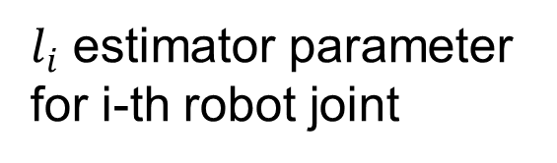
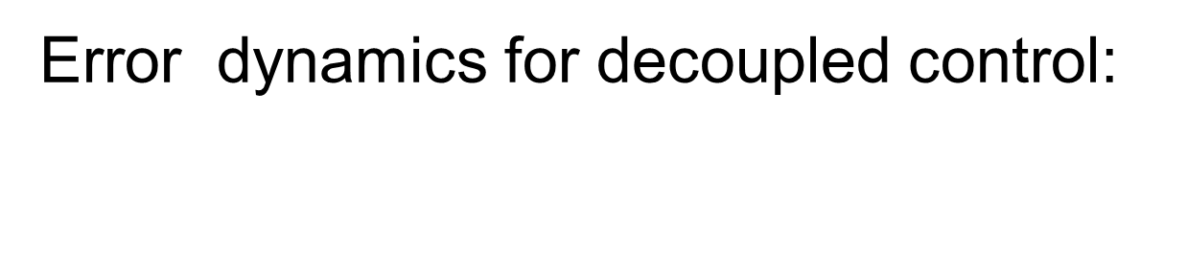
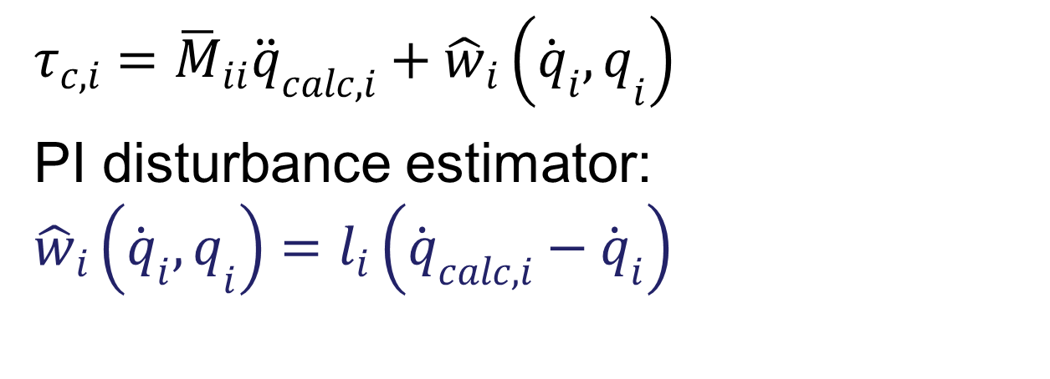
Design of disturbance estimator
$$τ_{c,i}={\overline{M}}_{ii}{\ddot{q}}_{calc,i}+{\hat{w}}_{i}\left({{\dot{q}}_{i},q}_{i}\right)$$
PI disturbance estimator:
$${\hat{w}}_{i}\left({{\dot{q}}_{i},q}_{i}\right)=l_{i}\left({\dot{q}}_{calc,i}−{\dot{q}}_{i}\right)$$
$l_{i}$ estimator parameter for i-th robot joint
Error dynamics for decoupled control:
Notes:
We had eddot=u+w

Slide 7
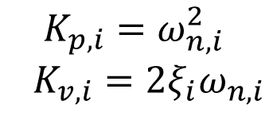
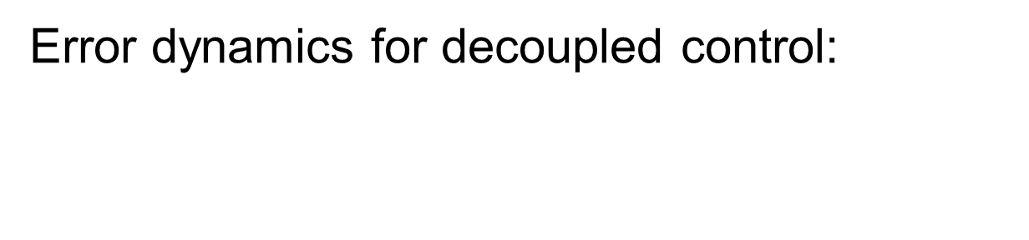
Design of disturbance estimator
Error dynamics for decoupled control:
Which part of transfer function determines time response?
The controller’s poles are:
$$K_{p,i}=ω_{n,i}^{2}$$
$K_{v,i}=2ξ_{i}ω_{n,i}$
Notes:
We had eddot=u+w

Slide 8

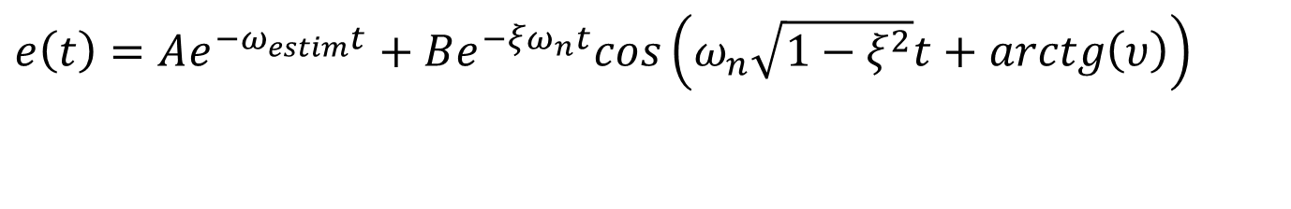

Position error in the time domain for the damping $ξ$<1 and impulse disturbance W(s)=1 (all frequencies included):
Design of disturbance estimator
$e\left(t\right)=Ae^{−ω_{estim}t}+Be^{−ξω_{n}t}cos\left(ω_{n}\sqrt{1−ξ^{2}}t+arctg\left(υ\right)\right)$
$$ω_{estim}/ω_{n}$$

Slide 9



Position error in the time domain for the damping $ξ=$1 and impulse disturbance W(s)=1
Design of disturbance estimator
$$e\left(t\right)={{−A}_{1}^{}e}^{−ω_{estim}t}+\left(A_{1}+B_{1}t\right)e^{−ω_{n}t}$$
$$ω_{estim}/ω_{n}$$

Slide 10
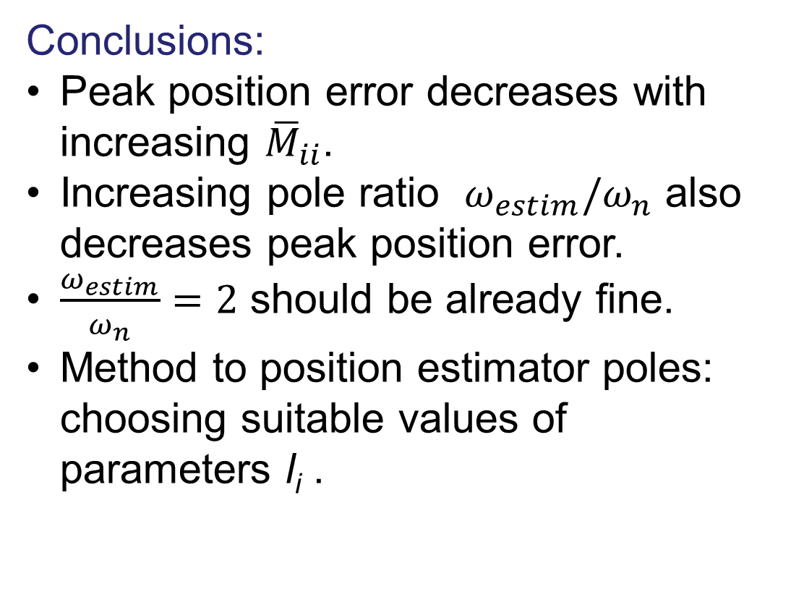
Design of disturbance estimator
Conclusions:
Peak position error decreases with increasing ${\overline{M}}_{ii}$.
Increasing pole ratio $ω_{estim}/ω_{n}$ also decreases peak position error.
$\frac{ω_{estim}}{ω_{n}}=2$ should be already fine.
Method to position estimator poles: choosing suitable values of parameters l_{i} .

Slide 11
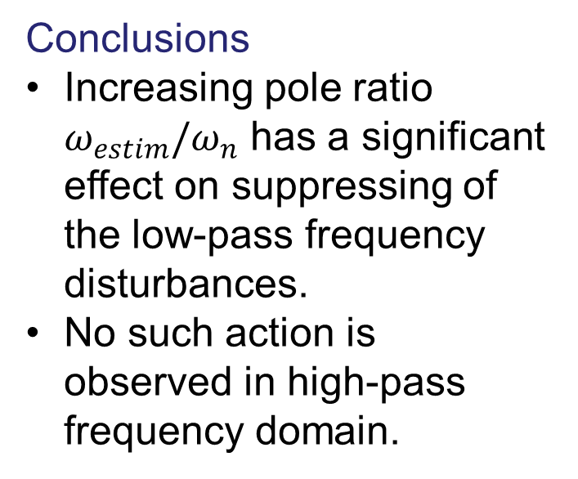
Design of disturbance estimator
Conclusions
Increasing pole ratio $ω_{estim}/ω_{n}$ has a significant effect on suppressing of the low-pass frequency disturbances.
No such action is observed in high-pass frequency domain.

Slide 12
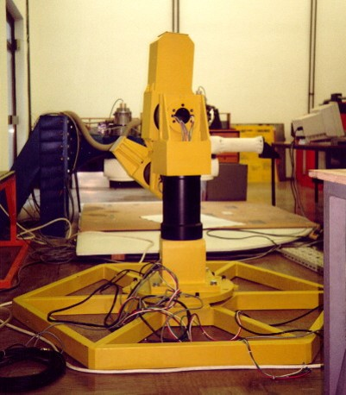
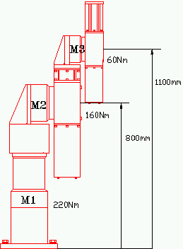
Design of disturbance estimator
Experimental results 3-DOF direct drive robot
Reference trajectory, joint space

Slide 13
Design of disturbance estimator
Tracking error of robot tip [mm] in task space for ξ=0.65
Tracking error of robot tip [mm] in task space for ξ=1
The suitable location of the poles determined by the pole ratio ω_{estim}/ω_{n}=2.0 or more, and damping factor being near critical ξ≅1 result in good performance.

Slide 14
Exercise: CT-like controller with PI disturbance estimator
REPORT REQUIRED
Draw the controller scheme.
Design the controller for 2-DOF robot and realize it by simulation in MATLAB/Simulink.
Test the performance for different parameters to confirm the efficiency of the controller and the results of analysis concerning the parameter’s influence.

Slide 15
Exercise: CT-like controller with PI disturbance estimator

